Slide 1

Building a secure, ethics-first AI solution (afternoon session)
Level 6 AI/ML Engineer
Higher Apprenticeship
Workshop 1

Slide 2
This check-in will take 30 minutes, and will be followed by resuming your hands-on exercises.

Slide 3
Check-in
How are you feeling after the morning session?
What went well?
What didn’t go so well?
What do you want to focus on this afternoon?

Slide 4
Workshop Objectives Re-cap
By the end of this workshop, learners will be able to:
Build and visualise a secure, ethical AI pipeline
Collaboratively analyse real-world pipeline risks, showcasing prioritisation and risk mitigation
Professionally document practical lessons learned.
Identify and critically examine how ethics and governance shape practical AI design and deployment decisions
Referring to the KSBs gained from this workshop, argue how personal ethical responsibilities shape an AI engineer’s learning focus and how ethics informs your own choices as an AI engineer.

Slide 5
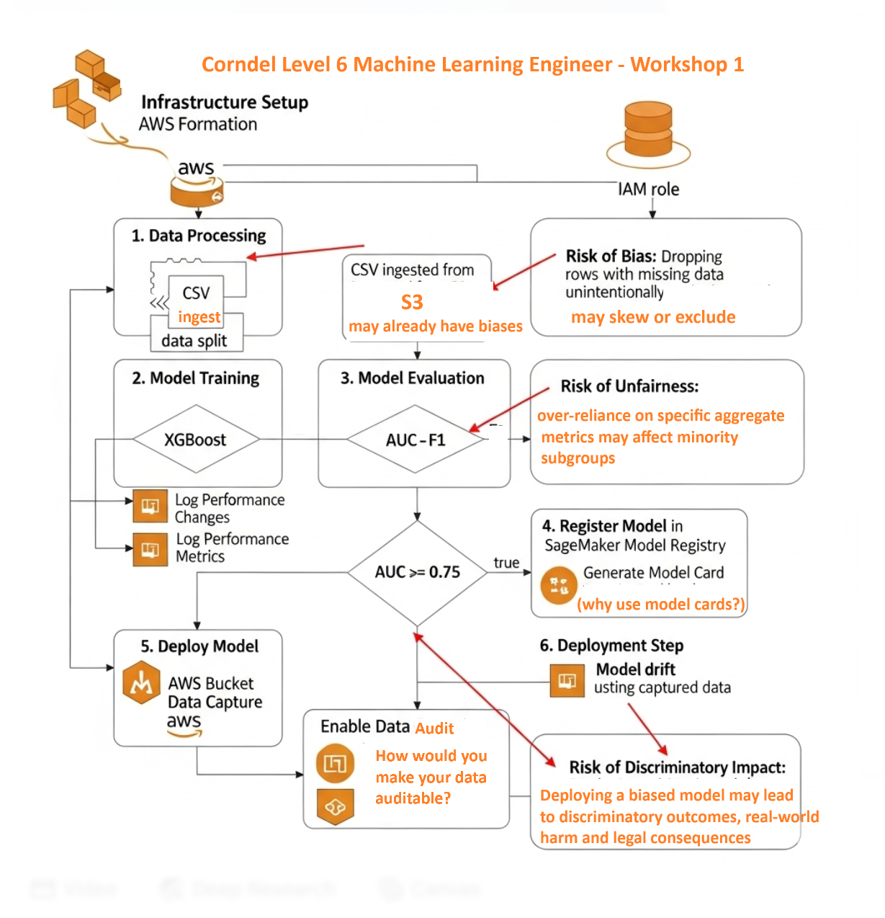

Slide 6
Structured Documentation

Slide 7
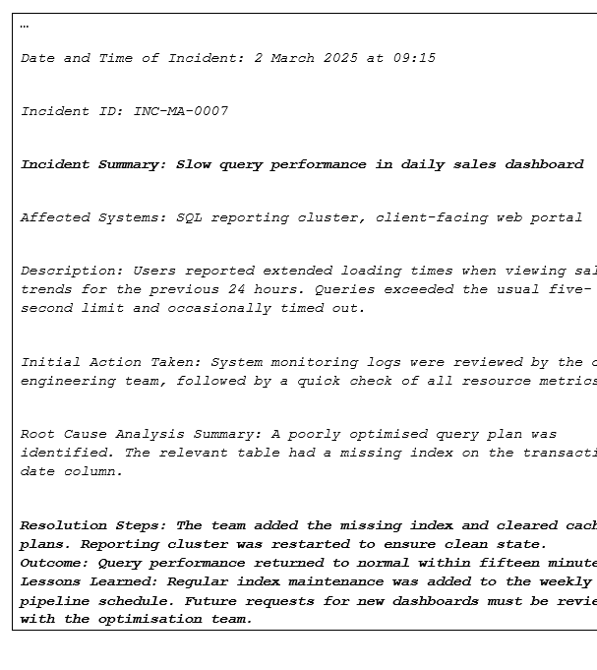
Learning from the past requires structured documentation
Systematically record each step, context, and outcomes.
Build a shared knowledge base across the team.
Reduce repeated mistakes by learning from past mistakes.
Accelerates onboarding of new team members.

Slide 8

How to successfully learn from documentation?
Structure. The team agrees on the structure of the documentation.
Blameless Culture. Documentation avoids attributing fault to any single person.
Version Control. All changes are versioned in a central repository so that improvements can be tracked.
Continuous Monitoring. Metrics are established and tracked.

Slide 9
Clarifying issues: Reflecting vs paraphrasing
Reflecting means repeating something back to your interlocutor using the same exact wording that they used.
PARAPHRASING means repeating something back to your interlocutor using your own words.
Is one better than the other?

Slide 10
Role-play practice
Practice the following active listening skills: paraphrasing, reflecting, clarifying and summarising.
In pairs, one participant needs to describe the latest data or AI project they were active on, and the other participant needs to summarise what they learned from listening.
Then they swap. The other participant needs to use clarifying to understand the other participant’s project better.
Also use reflecting (repeating periodically what they told you in their own words) and paraphrasing (repeating periodically what they told you in your own words).

Slide 11
Top tips: Active listening and effective questioning can help clarify different types of risks. All findings and risks must be documented. (How would you document ethical risks?)

Slide 12

You will now resume your remaining workshop tasks.

